Slide 1

Report Update
By Hermes, Eugene and Derek

Slide 2
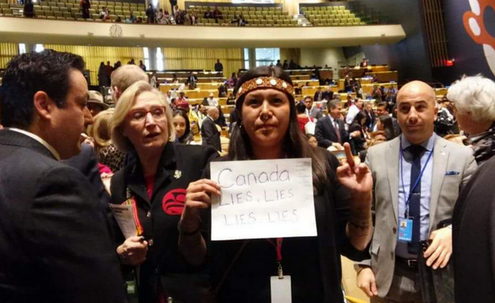
Updates on the topic
Government of Canada introduced Bill C-69 (February 8, 2018)
Eight tribal members were killed by government forces in the Lake Sebu area (3 December 2017)
Notes:
On February 8, 2018, the Government of Canada introduced Bill C-69 to reform the federal environmental impact assessment process. The proposed legislation provides the most significant illustration to date of how the federal government intends to meet its commitment to implement the United Nations Declaration on the Rights of Indigenous Peoples (UNDRIP).
On 3 December 2017, eight tribal members were killed by government forces for resisting logging and coffee farming on their ancestral lands in the Lake Sebu area. This is only the most recent example of private industry being favoured over local communities.

Slide 3
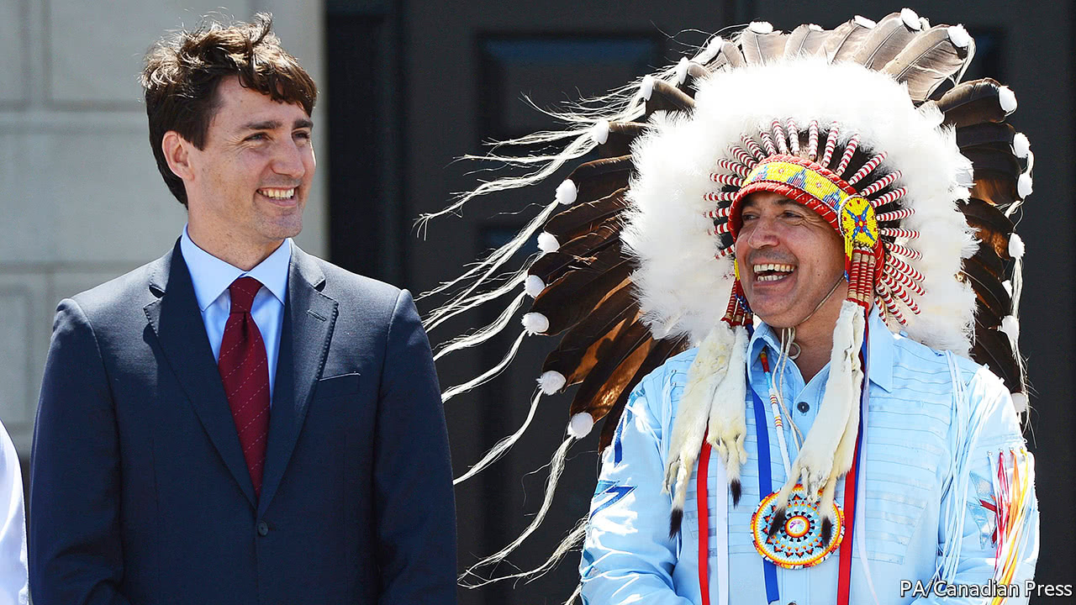
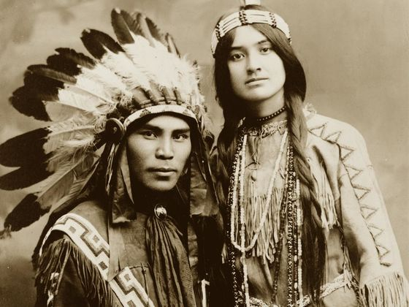

Who’s involved
Canada
America
Mexico
Russia
Australia
Notes:
https://www.un.org/development/desa/indigenouspeoples/unpfii-sessions-2/newmembers.html
https://www.economist.com/news/americas/21724386-governments-intentions-are-good-righting-historic-wrong-will-take-sustained
https://www.pinterest.com/pin/543739354983401362/
http://claimingpower.com/ancestors-with-facial-beauty/

Slide 4
Potential alliances arising
Greenpeace Canada
build strategic alliances with Indigenous communities
engage with these indigenous communities to negotiate with FPIC

Slide 5
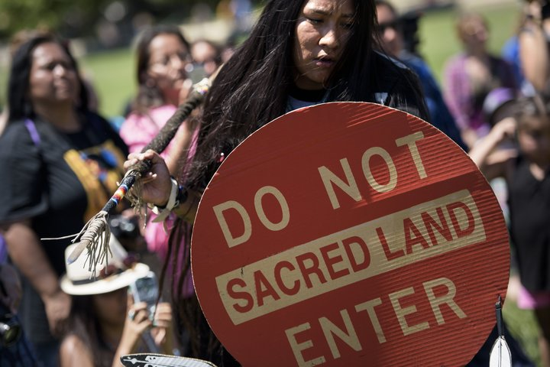
Miscellaneous important information
Interrelated issues regarding indigenous people
outside interests want to exploit the land (government, MNCs)
environmental defenders who try to protect their land get:
Charged
Threatened
Killed
Notes:
https://www.unenvironment.org/news-and-stories/story/us-land-life

Slide 6
Sources
https://canadians.org/blog/trudeaus-legislative-framework-indigenous-rights-should-begin-rethink-bill-c-69
https://www.un.org/development/desa/indigenouspeoples/unpfii-sessions-2/newmembers.html

